Slide 1
CS2006 Operating Systems
SPRING 2023
National University of Computer and Emerging Sciences

Slide 2
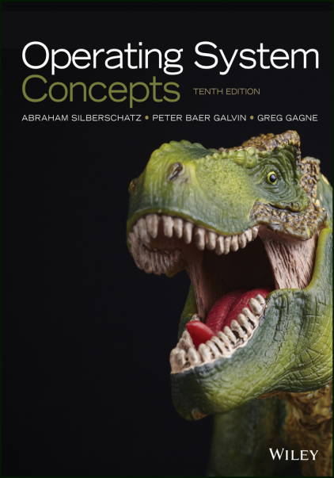
Instructor
Muhammad Danish Khan
Lecturer, Department of Computer Science
FAST NUCES Karachi
m.danish@nu.edu.pk
Office Location: Room#16, CS Block
Recommended Text Book
OPERATING SYSTEM CONCEPTS
ABRAHAM SILBERSCHATZ
10th Edition

Slide 3
Marks Distribution and Deadlines
Assessment | Weightage | Schedule/Deadlines/ Remarks
Mid-term I Examinations | 15 | 6th Week
Mid-term II Examinations | 15 | 12th Week
Quizzes/Assignments | 10
Semester Project | 10 | Project idea submission: 7th week, Final Submission due in 15th Week of the semester
Final Examinations | 50 | Comprehensively from all the covered and assigned topics.

Slide 4
Pre-Requisite
Programming
Data Structures

Slide 5
Semester Plan
Week 1: History of Operating Systems
Week 2: Introduction to Operating system
Week 3: Operating System Structure
Week 4: Process Concept
Week 5: Process Scheduling Algorithms
Week 6: Mid Term-1 Examinations

Slide 6
Semester Plan
Week 7: Multi-threaded Programming, Project Proposal Submission
Week 8: Memory management strategies
Week 9: Memory management strategies
Week 10: Virtual Memory
Week 11: Virtual Memory
Week12: Mid Term-2 Examinations

Slide 7
Semester Plan
Week 13: Process Synchronization
Week 14: Process Synchronization
Week 15: Dead Lock, Project Evaluations
Week 16: Protection and Security, Project Evaluations

Slide 8
LMS: Google Class Room
Code:
da6uswm
Invite Link:
https://classroom.google.com/c/NTg1OTAyMTYzOTU4?cjc=da6uswm

Slide 9
What is An Operating System
An operating system is software that manages a computer’s hardware.
It also provides a basis for application programs and acts as an intermediary between the computer user and the computer hardware.
A fundamental responsibility of an operating system is to allocate the hardware resources to programs

Slide 10
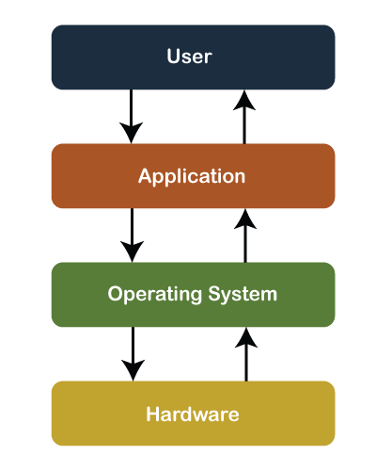
The Four Components of a Computer System
Notes:
Operating systems are everywhere, from cars and home appliances that include “Internet of Things” devices, to smart phones, personal computers, enterprise computers, and cloud computing environments.

Slide 11
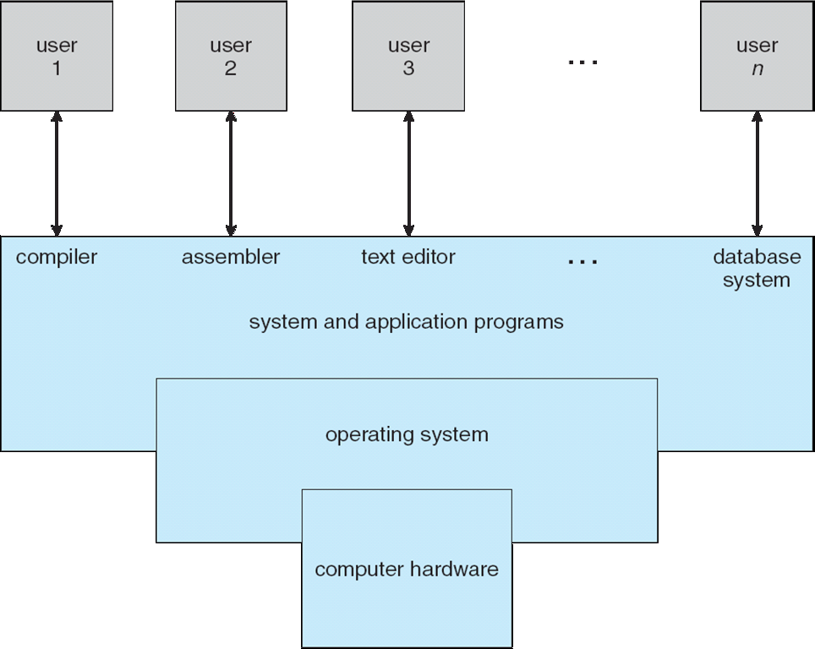

Slide 12
Operating System Definition
OS is a resource allocator
Manages all resources
Decides between conflicting requests for efficient and fair resource use
OS is a control program
Controls execution of programs to prevent errors and improper use of the computer
“The one program running at all times on the computer” is the KERNEL.

Slide 13
Computer Startup
bootstrap program is loaded at power-up or reboot
Typically stored in ROM or EPROM, generally known as firmware
Initializes all aspects of system
Loads operating system kernel and starts execution (boot)
Notes:
the term bootstrap means to boot or to load a program into a computer using a much smaller initial program to load in the desired program, which is usually an OS

Slide 14
Computer System Organization
Computer-system operation
One or more CPUs, device controllers connect through common bus providing access to shared memory
Concurrent execution of CPUs and devices competing for memory cycles

Slide 15
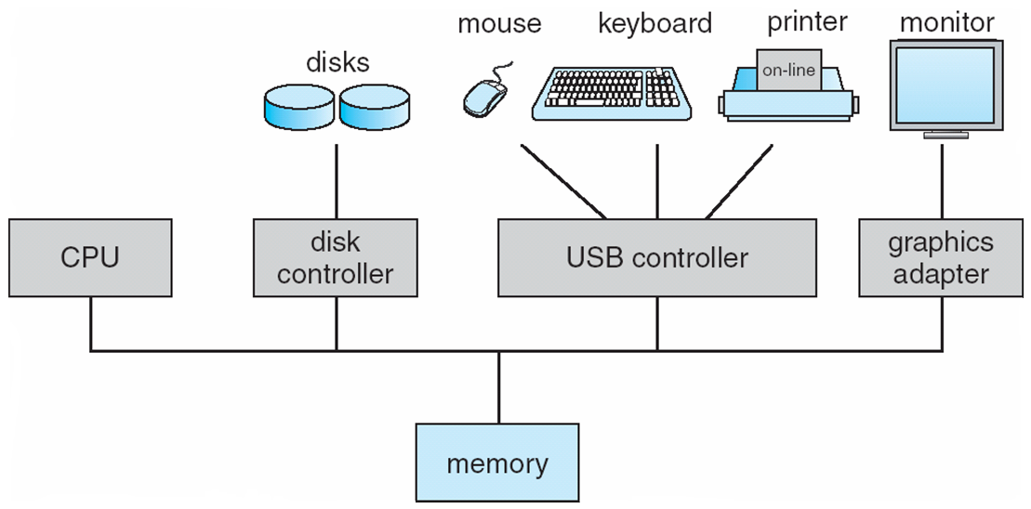

Slide 16
Computer-System Operation
Each device controller is in charge of a particular device type
Each device controller has a local buffer
CPU moves data from/to main memory to/from local buffers
Typically, operating systems have a device driver for each device controller.
This device driver understands the device controller and provides the rest of the operating system with a uniform interface to the device; operates in System Mode.
I/O is from the device to local buffer of controller

Slide 17
Device driver is a software that works as the interface for the device controller to communicate with the operating system or an application program.
Device controller is a hardware component that works as a bridge between the hardware device and the operating system or an application program.
Device controller informs CPU that it has finished its operation by causing an interrupt
Interrupts are used for many other purposes and are a key part of how operating systems and hardware interact.

Slide 18
Interrupts
When accessing I/O devices Polling is the approach where processor repeatedly monitors the status of device, it does not perform any useful tasks.
Processor polls the I/O device.
An alternate approach would be for the I/O device to alert the processor when it becomes ready.
Do so by sending a hardware signal called an interrupt to the processor.
At least one of the bus control lines, called an interrupt request line is dedicated for this purpose.
Processor can perform other useful tasks while it is waiting for the device to be ready
Notes:
Polled IO versus Interrupt Driven IO

Slide 19
Types of Interrupts
Hardware Interrupts (Interrupts)
Used by devices to communicate that they require attention.
hardware interrupt signals the CPU to suspend execution of the current program and execute an interrupt service routine.
Software Interrupts (Traps)
Software interrupts are used by programs to request system services.
Software interrupt occurs when a program calls an interrupt routine using the INT instruction.

Slide 20
Common Functions of Interrupts
Interrupt transfers control to the interrupt service routine generally, through the interrupt vector, which contains the addresses of all the service routines
Interrupt architecture must save the address of the interrupted instruction
An operating system is interrupt driven

Slide 21
Interrupt Handling
An interrupt alerts the processor for an immediate response.
The processor responds by suspending its current activities, saving its state, and executing a function called an interrupt handler (or an interrupt service routine, ISR) to deal with the event.
An interrupt handler or interrupt service routine (ISR) is the function that is executed by OS in response to a specific interrupt.
Interrupt numbers are used by devices to identify their own service routines.
Not every interrupt number has a corresponding interrupt routine
One interrupt number may have multiple functions, identified by function number. (e.g. INT 21h, see Appendix-D).

Slide 22
Interrupt Handling
The operating system preserves the state of the CPU by storing registers and the program counter
Separate segments of code determine what action should be taken for each type of interrupt; identified by interrupt number.
Notes:
The main difference between interrupt and polling is that, in the case of an interrupt, the system informs the CPU that it needs attention, while talking about polling, the CPU constantly inspects the status of the system to find whether it needs attention.

Slide 23
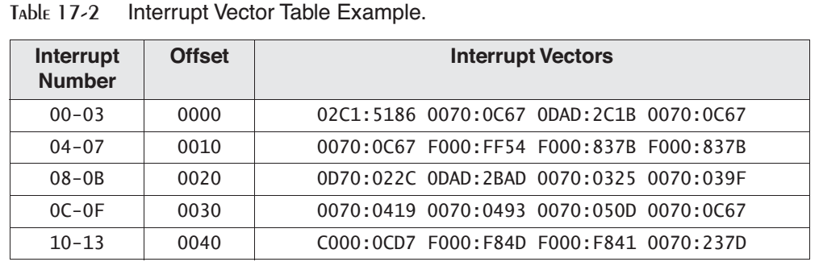

Slide 24
Operating-System Operations
Dual-mode operation allows OS to protect itself and other system components
User mode and kernel mode
Mode bit provided by hardware
Provides ability to distinguish when system is running user code or kernel code
Some instructions designated as privileged, only executable in kernel mode
System call changes mode to kernel, return from call resets it to user
Increasingly CPUs support multi-mode operations
i.e. virtual machine manager (VMM) mode for guest VMs

Slide 25
Transition from User to Kernel Mode
Timer to prevent infinite loop / process hogging resources
Set interrupt after specific period
Operating system decrements counter
When counter zero generate an interrupt
Set up before scheduling process to regain control or terminate program that exceeds allotted time

Slide 26
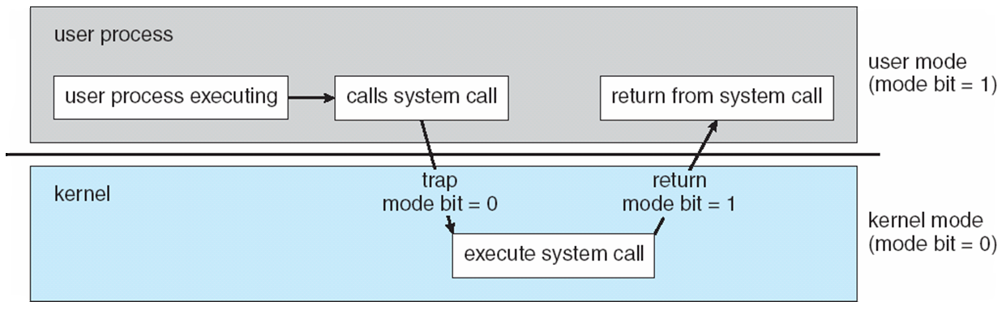

Slide 27
I/O Structure
After I/O starts, control returns to user program only upon I/O completion
Wait instruction idles the CPU until the next interrupt
Wait loop (contention for memory access)
At most one I/O request is outstanding at a time, no simultaneous I/O processing
After I/O starts, control returns to user program without waiting for I/O completion
System call – request to the OS to allow user to wait for I/O completion
Device-status table contains entry for each I/O device indicating its type, address, and state
Notes:
The CPU hardware has a wire called the interrupt-request line that the CPU senses after executing every instruction. When the CPU detects that a controller has asserted a signal on the interrupt-request line, it reads the interrupt number and jumps to the interrupt-handler routine by using that interrupt number as an index into the interrupt vector.

Slide 28
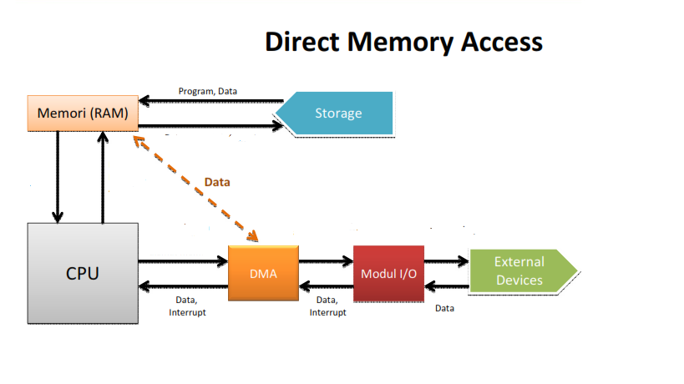
Direct Memory Access Structure
Used for high-speed I/O devices able to transmit information at close to memory speeds
Device controller transfers blocks of data from buffer storage directly to main memory without CPU intervention
Only one interrupt is generated per block, rather than the one interrupt per byte
Notes:
With DMA, the CPU first initiates the transfer, then it does other operations while the transfer is in progress, and it finally receives an interrupt from the DMA controller (DMAC) when the operation is done
Direct Memory Access (DMA) is a capability provided by some computer bus architectures that allows data to be sent directly from an attached device (such as a disk drive) to the memory on the computer's motherboard.

Slide 29
Storage Structure
Main memory – only large storage media that the CPU can access directly
Secondary storage – extension of main memory that provides large nonvolatile storage capacity
Magnetic disks – rigid metal or glass platters covered with magnetic recording material
Disk surface is logically divided into tracks, which are subdivided into sectors
The disk controller determines the logical interaction between the device and the computer

Slide 30
Storage Hierarchy
Storage systems organized in hierarchy
Speed
Cost
Volatility
Caching – copying information into faster storage system; main memory can be viewed as a cache for secondary storage
Device Driver for each device controller to manage I/O
Provides uniform interface between controller and kernel

Slide 31
Storage-Device Hierarchy

Slide 32
Caching
Important principle, performed at many levels in a computer (in hardware, operating system, software)
Faster storage (cache) checked first to determine if information is there
If it is, information used directly from the cache (fast)
If not, data copied to cache and used there

Slide 33
Computer-System Architecture
Multiprocessors systems growing in use and importance
Also known as parallel systems, tightly-coupled systems
Advantages include:
Increased throughput
Economy of scale
Increased reliability – graceful degradation or fault tolerance
Two types:
Asymmetric Multiprocessing
Symmetric Multiprocessing

Slide 34
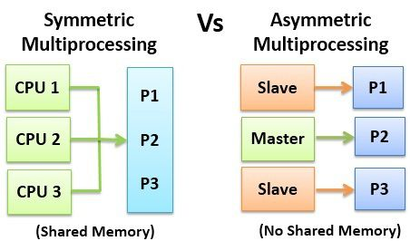

Slide 35
Operating System Structure
Multiprogramming needed for efficiency
Single user cannot keep CPU and I/O devices busy at all times
Multiprogramming organizes jobs (code and data) so CPU always has one to execute
A subset of total jobs in system is kept in memory
One job selected and run via job scheduling
When it has to wait (for I/O for example), OS switches to another job

Slide 36
Operating System Structure
Timesharing (multitasking) is logical extension in which CPU switches jobs so frequently that users can interact with each job while it is running, creating interactive computing
Response time should be < 1 second
Each user has at least one program executing in memory process
If several jobs ready to run at the same time  CPU scheduling
If processes don’t fit in memory, swapping moves them in and out to run
Virtual memory allows execution of processes not completely in memory

Slide 37
Some Relevant Concepts
Program
Set of instructions and associated data
resides on the disk and is loaded by the operating system to perform some task.
E.g. An executable file or a python script file.
Process
A program in execution.
In order to run a program, the operating system's kernel is first asked to create a new process, which is an environment in which a program executes.
consists of instructions, user-data, and system-data segments, CPU, memory, address-space, disk acquired at runtime

Slide 38
Thread
the smallest unit of execution in a process.
A thread simply executes instructions serially.
A process can have multiple threads running as part of it.
Processes don't share any resources amongst themselves whereas threads of a process can share the resources allocated to that particular process, including memory address space.

Slide 39
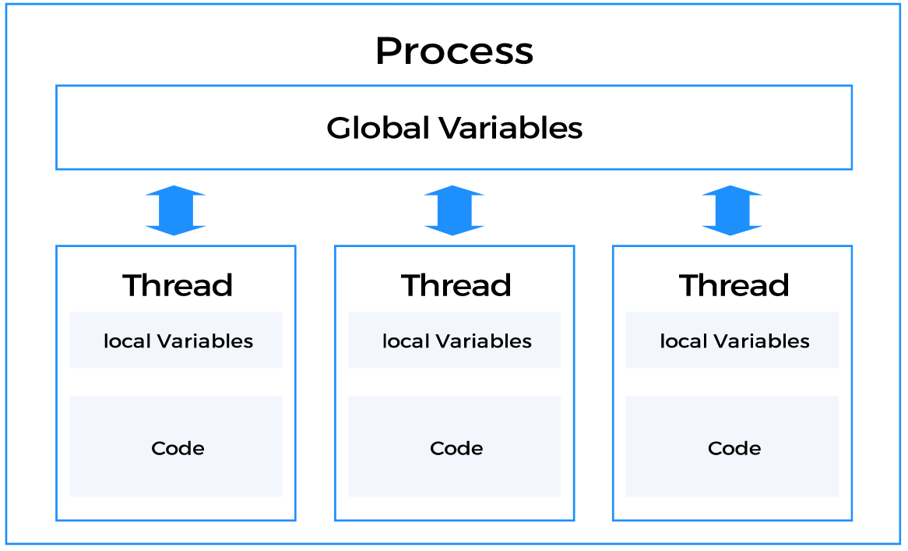
Notes:
An execution state (Running, Ready, etc.)
Saved thread context when not running
Suspending a process involves suspending all threads of that process
Termination of a process terminates all threads within the process

Slide 40
“Multiprocessing systems”
where multiple processes get scheduled on more than one CPU.
Usually, this requires hardware support where a single system comes with multiple cores
or the execution takes place in a cluster of machines.
Multiple Processors vs Multiple Cores

Slide 41
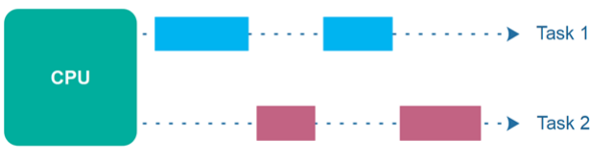
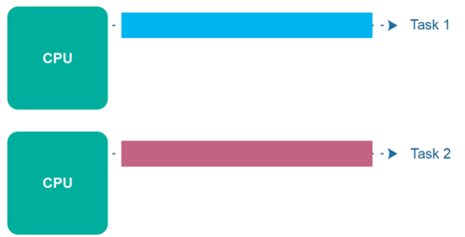
Concurrency
Parallel Execution

Slide 42
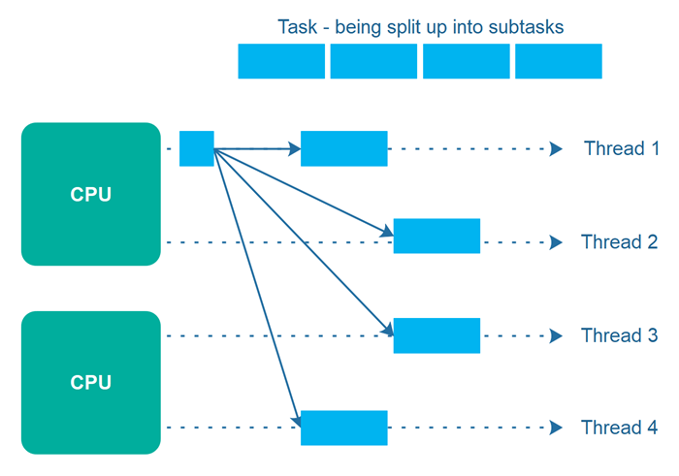

Slide 43
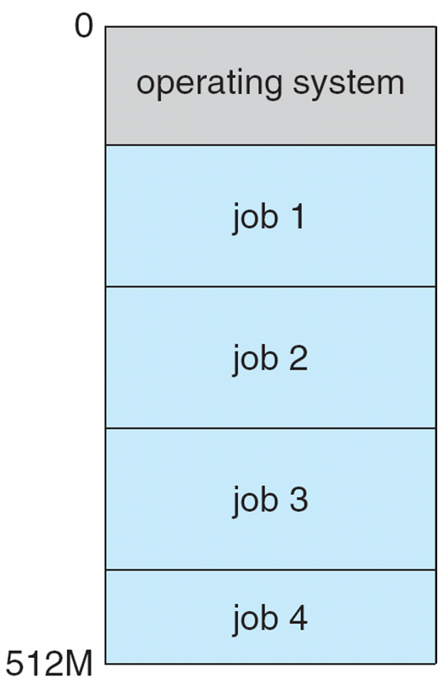
Memory Layout for Multi-programmed System

Slide 44
Process Management
A process is a program in execution. It is a unit of work within the system. Program is a passive entity, process is an active entity.
Process needs resources to accomplish its task
CPU, memory, I/O, files
Initialization data

Slide 45
Process Management
Program counter (PC): Contains the address of an instruction to be fetched
Single-threaded process has one program counter specifying location of next instruction to execute
Multi-threaded process has one program counter per thread

Slide 46
Process Management Activities
The operating system is responsible for the following activities in connection with process management:
Creating and deleting both user and system processes
Suspending and resuming processes
process synchronization
process communication
deadlock handling

Slide 47
Memory Management
Memory management activities
Keeping track of which parts of memory are currently being used and by whom
Deciding which processes (or parts thereof) and data to move into and out of memory
Allocating and deallocating memory space as needed

Slide 48
Storage Management
File-System management
Files usually organized into directories
Access control on most systems to determine who can access what
OS activities include
Creating and deleting files and directories
Primitives to manipulate files and directoriess
Mapping files onto secondary storage
Backup files onto stable (non-volatile) storage media

Slide 49
Mass-Storage Management
OS activities
Free-space management
Storage allocation
Disk scheduling
Some storage need not be fast
Tertiary storage includes optical storage, magnetic tape
Still must be managed – by OS or applications
Varies between WORM (write-once, read-many-times) and RW (read-write)

Slide 50
Protection and Security
Protection – any mechanism for controlling access of processes or users to resources defined by the OS
Security – defense of the system against internal and external attacks
Huge range, including denial-of-service, worms, viruses, identity theft, theft of service

Slide 51
Computing Environments - Traditional
Portals provide web access to internal systems
Network computers (thin clients) are like Web terminals
Mobile computers interconnect via wireless networks

Slide 52
Computing Environments - Mobile
Handheld smartphones, tablets, etc
What is the functional difference between them and a “traditional” laptop?
Extra feature – more OS features (GPS, gyroscope)
Leaders are Apple iOS and Google Android

